Slide 1
The Effectiveness of Recruiting and Employee Selection Methods
Name
Course code
Department
Professor
Date

Slide 2

Introduction
The process of finding and recruiting talented employees is vital for any business.
Companies have difficulties in finding, keeping and replacing employees (Edmund, 2019).
An effective recruitment process is critical for cutting down on the employee turnover and cost of replacing employees (Plaskoff, 2017).
Notes:
Finding and retaining talented employees is a vital part of any successful business. Yet qualified employees can be difficult to find and hard to keep around, and replacing a salaried employee costs an average of 6–9 months salary.
Companies can cut down on employee turnover and cost of replacing an employee by having an effective recruitment process in place.

Slide 3
Recruitment of a Registered Nurse
Requirements
Proven experience as a registered nurse
Excellent knowledge of nursing care methods and procedures
Excellent knowledge of emergency care
In-depth knowledge of health and safety guidelines and procedures (sanitation, decontamination etc.) and willingness to follow them at all times
A team player with excellent communication and interpersonal skills
Be responsible and compassionate
Outstanding organizational and multi-tasking skills
Patient with excellent problem-solving skills
Holder of a BSc or other diploma from a nursing program
Possess a valid nursing license

Slide 4
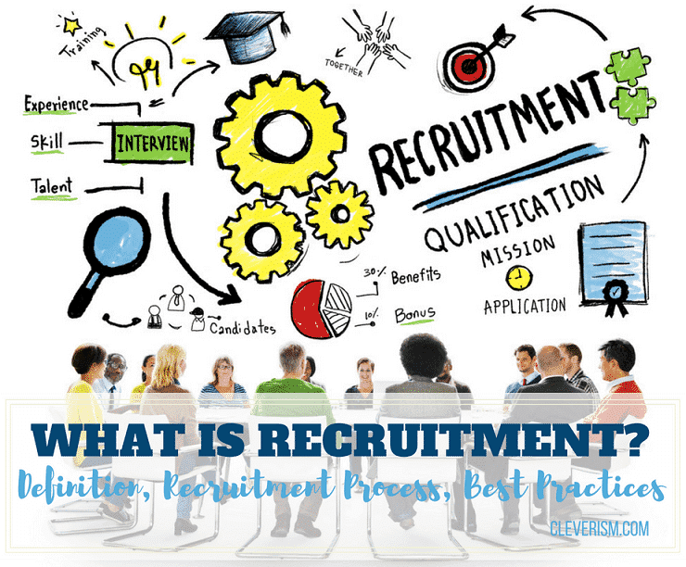
The Recruitment Process in HR
The recruitment process of filling job openings in an organization by drawing and selecting new employees.
The recruitment process involves the managers, Human Resource Management (HRM) and recruiters (Edmund, 2019).
The HRM takes a lead in the process and collaborates with relevant departments.
The goal is to find a candidate with the best skills, experience, and personality to fit the job (Flory et al., 2021).
Notes:
The recruitment process is the steps to drawing in and selecting a new employee to fill an opening in an organization. This job is usually done by managers, Human Resource Management (HRM), recruiters, or a combination of all three. Human resource managers typically lead this process, collaborating with relevant departments and team members to streamline recruitment.
The recruitment process involves finding the candidate with the best skills, experience, and personality to fit the job. It requires a series of collecting and reviewing resumes, conducting job interviews, and finally selecting and onboarding an employee to start working for the organization.

Slide 5
Good Recruitment Process
A good recruitment process is achieved through internal planning and consistent evaluation with a goal of efficiently finding a qualified candidate (Flory et al., 2021).
An efficient recruitment process is achieved by through:
Maximized automation
Making data-driven decisions
Creating an employee referral program
Developing an employer brand
Notes:
A good recruitment process allows you to find qualified candidates quickly and efficiently. The process requires intentional planning and constant evaluation.
The recruitment process should be streamlined so each staff member has the tools and resources they need for their step in the process. For example, if a manager is tasked with conducting interviews, the recruiter or HR manager should make the process easier by providing the manager with a printed resume and background on the employee before the interview begins.
Use an applicant tracking system (ATS) to maximize your automation needs. You’ll be able to automate where you’re posting job listings, track the number of applicants, and filter resumes to find the most qualified applicants.
Invest in a comprehensive data analytics system to see how many people applied for a job, how many people were interviewed, where the best candidates came from, etc. Reflecting on the process with each hire will help improve the recruitment process over time.
Create an employee referral program to involve your employees in the recruitment process. They’ll be more motivated to spread the word about the opening, and they’ll likely lead you to more qualified candidates for the job.
Recruitment is a two-way street. Just as candidates invest time to impress potential employers by sharing their experience and skills, your business should do the same in attracting talent by illustrating why people should work for you. Think about the mission and values of the company. Are they displayed effectively across your website and social media pages?

Slide 6

The Recruitment Process
The recruitment process has the following steps:
Identification of needs
Preparation of job description
Developing a recruitment plan
Start candidate search
Recruitment of top-tier candidates
Phone screening
Interview in person
Job offering
Onboarding the new employee
Notes:
Create a list of needs before you create a job posting. It may seem easy to identify the hiring need when you’re replacing an employee who just left, but the task gets more difficult if you’re creating a new position or changing the responsibilities of a role.
Job descriptions help communicate the organization’s needs and expectations to a potential candidate. It’s essential to be as specific as possible in the job description to attract and meet candidates who can sufficiently meet the demands of the role.
3. Strategize the best ways to get the word out about the job. Determine who will be reviewing resumes, scheduling interviews, and deciding on the right candidate.
4. Use keyword recruitment tools to cut down on your search time during the recruitment process
5. The best candidates likely have many options, and you’ll need to maintain timely communication or they’ll quickly move on to other opportunities. Once you have your eye on certain applicants, conduct a phone screening to narrow down the selection process and make sure you want to take the time to interview the candidate in person.
8. The interview should be conducted as soon as possible and a job offer should be presented to the best candidate and get started on the job onboarding process.

Slide 7

How to Increase Diversity in Sourcing
Audit the job advertisements
Targeting sources where diverse candidates congregates
Encourage the diverse employers to refer their connections
Provide internship opportunities to diverse groups
Develop a brand that showcases and promotes diversity (Plaskoff, 2017).
Use blind resumes and blind interviews
Notes:
A great way to ensure that you’re hiring a diverse range of people is to make sure there’s diversity in who is applying to your positions to begin with.
best ways to recruit diverse candidates is to do an audit of your past recruitment ads, and make changes to speak to a broader range of candidates. find ways to be more inclusive in your language to appeal to candidates from different backgrounds.
Don’t rely on the same sources over and over again when seeking out new candidates. Source your candidates from a variety of different places where they typically hang out. For example, there are many online and offline groups dedicated to women in technology.
It’s very likely that members of your team will have networks of people with similar backgrounds to them.
Many companies have started internal diversity programs that offer internship and co-op positions to candidates from specific backgrounds. This is a great way to encourage up-and-coming candidates in your industry to join your team and get experience.
5. Perhaps the best way to boost diversity in your candidate sourcing is to organically create an employer brand that values people and opinions from all walks of life. Talk about the benefits and importance of diversity with your team, get their buy in and engrain those values into your company culture.
6. An increasingly popular technique recruiters are using to remove bias from how they screen candidates is to “black out” any and all personal information on resumes and during interviews.

Slide 8

Employee Selection Methods
Assessing cognitive abilities
Evaluating learning agility
Conducting situational judgement tests
Testing for job knowledge
Notes:
1. Cognitive ability is the number one predictor of job performance across all employment levels and industries. Cognitive ability assessments are used to evaluate how well candidates use a wide range of mental processes, such as working with numbers, abstract thinking, problem-solving, reading comprehension, and learning agility.
2. Learning agility is the ability to be in a new situation, not know how to handle it, and then figure it out anyway. “The illiterate of the 21st century will not be those who cannot read and write, but those who cannot learn, unlearn and relearn,” Alvin Toffler.
3. A great way to enhance employee selection is to assess situational judgement capabilities. Situational Judgement Tests (SJT) present candidates with various scenarios that they might experience if they’re selected for the specific role they’re applying for.
4. Does the candidate have the actual knowledge needed to do the job in question? While most of the time that knowledge can be learned on the job and other factors are more important, there are certain roles that require applicants to possess specific job knowledge and skills already.

Slide 9
Reference
Edmund, M. (2019). 2019 Workplace Trends to Watch. Quality Progress, 52(1), 10-12.
Flory, J. A., Leibbrandt, A., Rott, C., & Stoddard, O. (2021). Increasing Workplace Diversity Evidence from a Recruiting Experiment at a Fortune 500 Company. Journal of Human Resources, 56(1), 73-92.
Cahigas, M. M. L., Robielos, R. A. C., & Gumasing, M. J. J. Application of Multiple Criteria Decision-Making Methods in the Human Resource Recruitment Process.
Plaskoff, J. (2017). Employee experience: the new human resource management approach. Strategic HR Review.

